Slide 1

TOWER OF HANOI SIMULATOR

Slide 2
Submitted By
Saurabh Singh

Slide 3
1.
INTRODUCTION

Slide 4
Tower Of Hanoi
Tower of Hanoi is a mathematical puzzle where we have three rods(A, B, and C) and N disks.
Initially the disks are stacked in decreasing value of diameter i.e., the smallest disk is placed on the top and they are on rod A.
The objective of the puzzle is to move the entire stack to another rod (say C), obeying certain rules.

Slide 5
Rules:
Only one disk can be moved among the towers at any given time.
Only the "top" disk can be removed.
No large disk can sit over a small disk.
Tower of Hanoi can be easily visualized and understood from a simulator.
Technology Used:
Python Tkinter
Pyhton Turtle Graphics

Slide 6
2.
Python Tkinter

Slide 7
Python Tkinter
Python offers multiple options for developing GUI (Graphical User Interface).
Out of all the GUI methods, tkinter is the most commonly used method.
Python with tkinter is the fastest and easiest way to create the GUI applications.
Tkinter provides various controls, such as buttons, labels and text boxes used in a GUI application.

Slide 8
3.
Python Turtle Graphics

Slide 9
Python Turtle Graphics
Turtle is a Python library which used to create graphics, pictures, and games.
It was a part of the original Logo programming language.
It is like a little object on the screen, which can move according to the desired position.
Turtle library comes with the interactive feature that gives the flexibility to work with Python.

Slide 10
4.
The Simulator

Slide 11
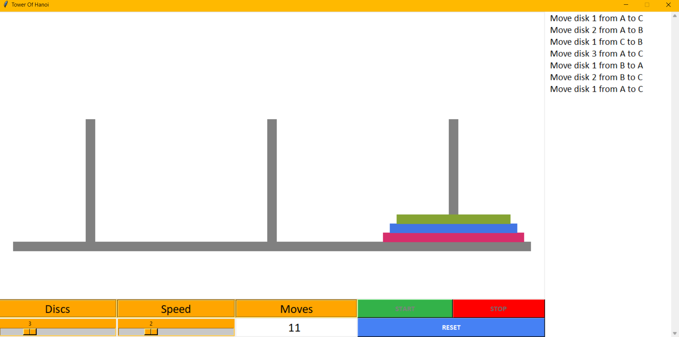
Tower Of Hanoi Simulator
11
1
10
2
9
3
4
5
6
7
8

Slide 12
Label Meanings
→ Source Rod.
→ Auxiliary Rod.
→ Is used to select number of dicks to start with.
→ Is used to set the speed of the animation.
→ Show total number of moves taken to move the entire stack from source to . destination rod.
→ Start Button to start the simulation.
→ Reset Button to reset the simulator to initial state.
→ Stop Button to stop the simulation when required.
→ Disks
→ Destination Rod
→ This area keeps log of all the moves

Slide 13
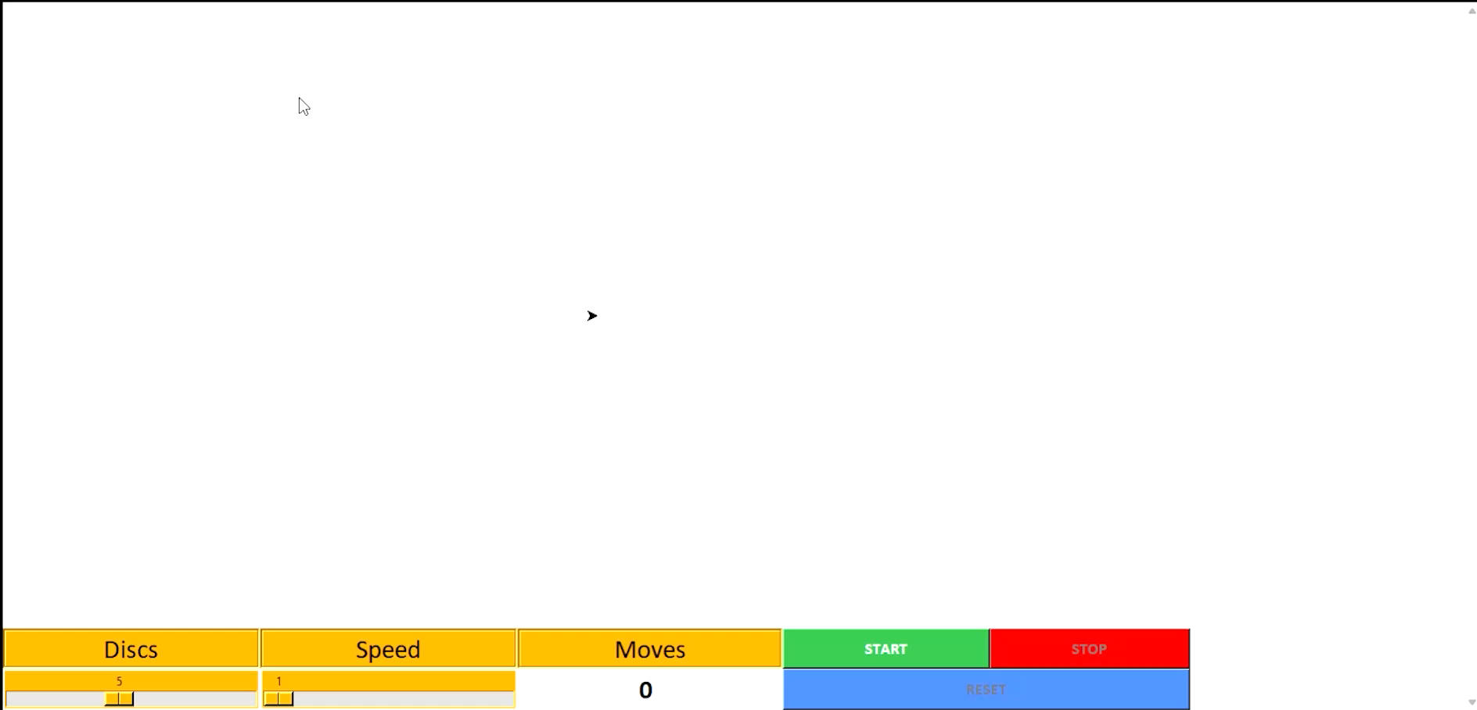
Working

Slide 14
Thank You!

